Slide 1
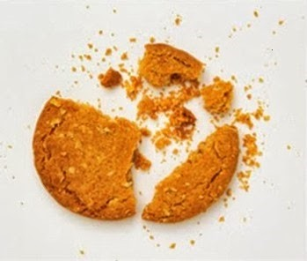

Test Automation Using Selenium
Fair Hike Academy
That’s the way the cookie crumbles!
Session 19: Source Code Management - SubVersion
Mentor : Naresh Vulli, CSTE, PAHM.
fairhike@gmail.com www.fairhike.blogspot.com | www.facebook.com/fairhike

Slide 2
Today’s Topics
Recap
Server and Client Repository
SVN – Server & Client Setup
VisualSVN Server
TortoiseSVN Client
Create and Add Project to Repository
Take Local copy
Code Check-in and CheckOut
Takeaways or Exercise

Slide 3
Server and Client - Repository
Server:
A centralized location where we keep all our code base
Every developer makes changes on the latest code base available at that location
Client :
Provides a way to connect to the server
Check-in local code changes
Always gets latest code base

Slide 4
SVN - Server and Client Setup
Server: VISUALSVN SERVER
https://www.visualsvn.com/server/
Client : TortoiseSVN
https://tortoisesvn.net/downloads.html

Slide 5
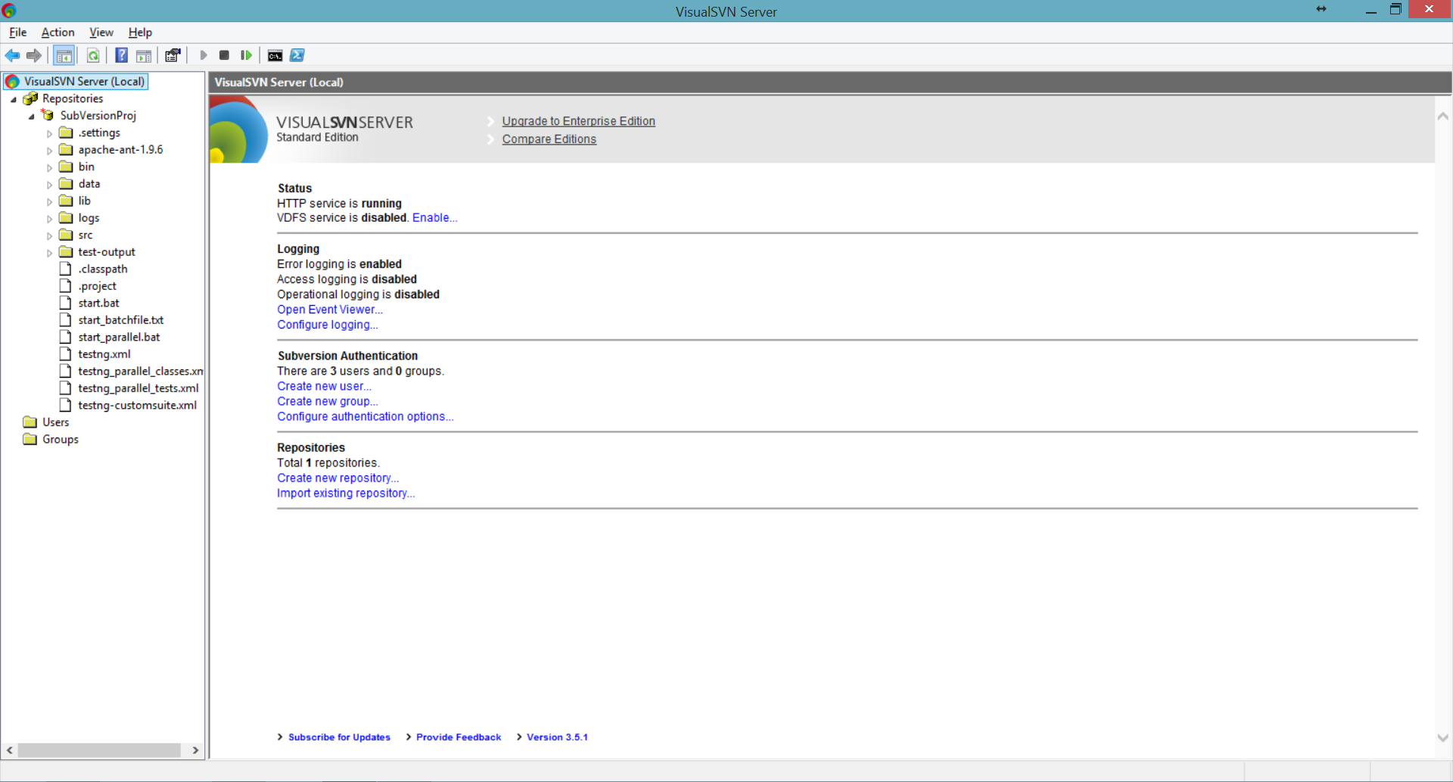
VisualSVN Server

Slide 6
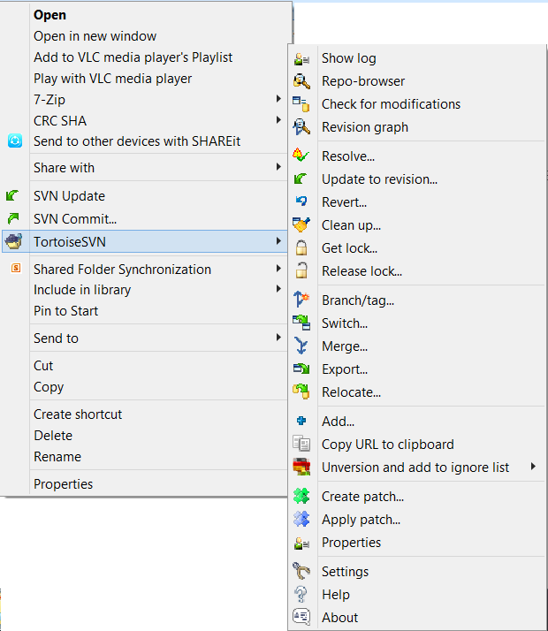
TortoiseSVN Client

Slide 7
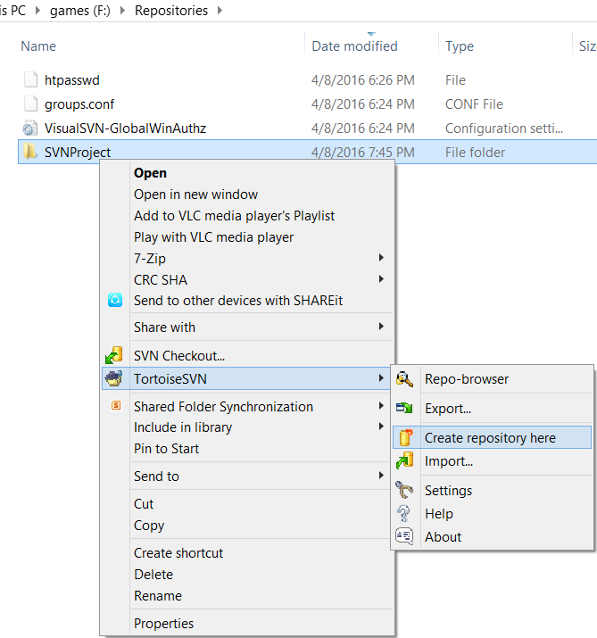
Create Repository
Go to Default Repository Folder
Create a NewFolder and Name it
Right click and select “Create Repository here” option

Slide 8
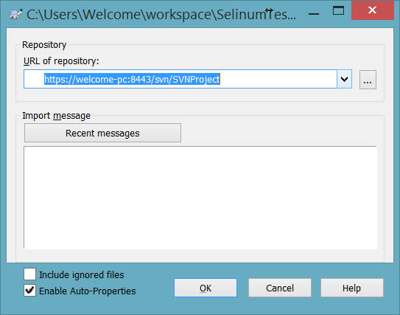
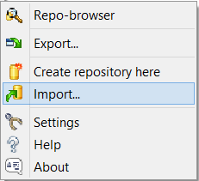
Add Project to Repository
Go to your Project Folder
Right click and select “Import” option

Slide 9
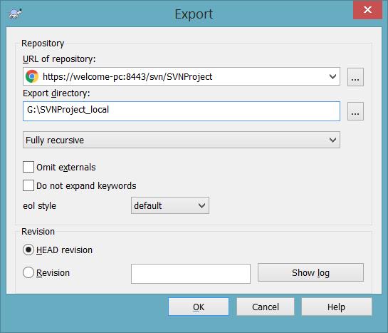
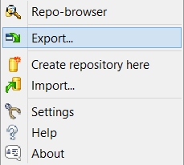
Take a copy of Server code base
Right click and select “Export” option

Slide 10
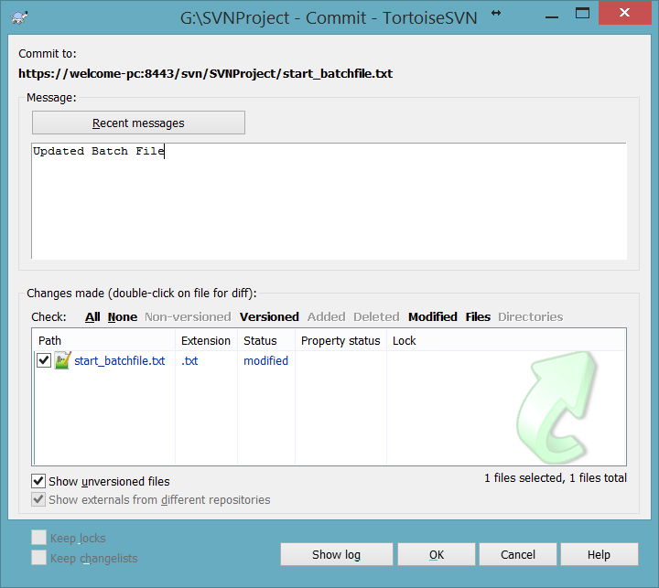

Code Check-in and Checkout
Make changes to Any file and select SVN Commit to check-in the changes to server

Slide 11
Takeaway or Exercise
Setup a SVN Server and Client – do a simple code change Check-in

Slide 12
Q & A

Slide 13
Thank You ☺

